Slide 1
Literacy workshop- KS2

Slide 2
The main changes
- Specific SPaG – grammar and spelling schemes of work
(including grammar terminology and statutory word lists)
New emphasis on developing a wide vocabulary (across all subjects) – speaking as well as writing
Some phonics extended into Year 3/4 or used until the children are ready.
Some grammar & spelling expectations moved earlier

Slide 3
Handwriting
KS1- Handwriting 2 times a week.
Practical.
Writing in handwriting books and handwriting folders.
Links to different handwriting families- curly caterpillars, one armed robot etc.
KS2- Handwriting at least once a week.
Writing in handwriting books and handwriting folders.
After half term will be introducing the daily handwriting sessions and these will be supported using http://www.letterjoin.co.uk/

Slide 4
Cursive writing
Handwriting power point
Look at the cursive sheets on your table to help you.
Please write- The quick brown fox jumps over the lazy dog.

Slide 5
Curriculum expectations in year 3
Grammar and Punctuation:
Nouns and prefixes such as super_, anti_, auto_
Determiners a and an
Consonant and vowels
Conjunctions
Adverbs
Prepositions
Paragraphs
Headings and subheadings
Perfect form of verbs
Inverted commas
Clauses
Word families

Slide 6
Curriculum expectations
in year 4
Grammar and Punctuation:
Plurals and the possessive –s
Verb inflections
Fronted adverbials
Pronouns and nouns
Paragraphs
Inverted commas
Commas
Apostrophes
Singular and plural possessions

Slide 7
Curriculum expectations
in year 5
Grammar and Punctuation:
Converting nouns or adjectives into verbs using suffixes
Verb prefixes
Relative clauses/relative pronouns
Modal verbs
Adverbs
Paragraphs
Adverbials
Brackets, dashes and commas
Determiners
Parenthesis (brackets)

Slide 8
Curriculum expectations
in year 6
Grammar and Punctuation:
Informal and formal speech and writing
Passive voice/active voice
Expanded noun phrases
Adverbials
Ellipsis
Layout devices (sub-headings, columns, bullet points)
Semi-colon, colon, bullet points and dashes
Hyphens
Synonyms and antonyms

Slide 9
The big write
It is a philosophy about writing which was
originally devised by Ros Wilson. (A former
teacher and Ofsted Inspector).
It is based on the idea that to write well
children need to feel confident and motivated.
Children need to be able to talk . They need to ‘have a go’. If a child can say it a child can write it.
It is a way to assess children’s writing and provide next steps.

Slide 10
Children are encouraged to…
Talk about what they will write.
Find exciting wow words and use them in their writing.
- ‘Borrow’ exciting words and phrases from other writers.
Have a go at using interesting punctuation.
Re-read their own writing and find ways to make it better.
Understand what they need to do next to improve.

Slide 11
What is the big write?
Over two weeks the children will concentrate on the four main elements of Big writing.
V- Vocabulary
C- Connectives
O- Openers
P- Punctuation
VCOP

Slide 12
Vocabulary
Every class has a 'Wow Words' board where new and impressive words that the children have used and have found in good quality texts, are shared with everyone.
The children are encouraged to use these words where appropriate in their writing.

Slide 13
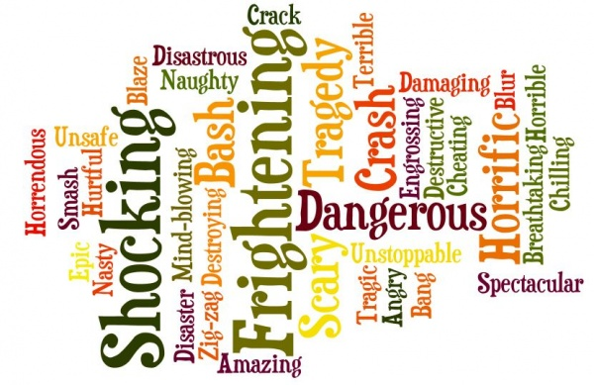

Slide 14
Can you think of as many different ways to improve these words with a partner?
nice
good
bad
big
like
happy

Slide 15
Openers
Every class displays and discusses good sentence ‘openers’ (sentence starters) that the children can use in their writing to make their sentences and overall texts more interesting.
Teach ways of improving a basic sentence by changing how it begins e.g. ‘She opened the door’ to a better sentence, 'Cautiously, she opened the door.'
.

Slide 16
Choose an opener. What is the most interesting way to finish the sentence?
Nervously…
Laughing…
If only I…
To my great surprise…
Reluctantly…
I’ll never forget the day that…
Sleepily…
Earlier…
I couldn't believe my eyes when…

Slide 17
Connectives
Every class displays examples of powerful connectives. The children are encouraged to use these in their writing to join sentences and paragraphs, therefore improving the organisation of their writing.

Slide 18
Connective
1. Start from the left of the board and try to use any of the connectives in the first column.
so
unless
meanwhile
however
and then
because
whilst
whereas
4. The aim of the game is to move all the way across the board.
but
whenever
2. If you use it correctly, move to a connective in the next column.
although
or
despite
until
as
as well
then
even though
3. If you use a connective incorrectly then you can no longer use this word and must find an alternative route across the board.

Slide 19
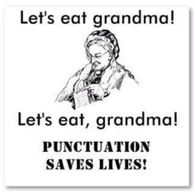
Punctuation
The teaching of punctuation is based on the ‘Punctuation Pyramid.’
Children start by using full stops, then question marks followed by commas and an exclamation mark.
Eventually they should use the higher order punctuation such as ( ) ; : etc.

Slide 20
Punctuation
Punctuation game
Kung Fu punctuation- find a space and please join in with the actions.

Slide 21
Level 1 | .
Level 2 | . ?
Level 3 | . ? , !
Level 4 | . ? , ! … ’ “”
Level 5 | . ? , … - ! ’ “” : ; ( )
The Punctuation Pyramid
Notes:
Mention ‘Kung Fu’ punctuation. Multi sensory approach.

Slide 22
When does it happen?
Big writing happens once a fortnight on a Friday morning with children being encouraged to write at length using all the skills they have learnt.
The lighting is sometimes changed and music is played softly in the background.
In this way they will be building their writing stamina and experimenting with a variety of genre from reports, persuasive text and instructions, to character descriptions, creative writing, poetry and story writing.

Slide 23
Big writing progression
EYFS children have a large focus on talk for writing and shared writing as a whole class during the autumn and spring term. In the summer term children will have a ‘Big Talk’ session and generate ideas then write with minimal support.
Year 1 have a ‘Big Talk’ session, where ideas are generated and built with the teacher’s support. By the end of year one the children will talk and then write for 30 minutes.
Year 2 talk and plan for 30 minutes and write for 30 minutes. This will build towards 45 minutes by the end of year two.
KS2 talk and plan for 30minutes (20minutes VCOP, 10 minutes planning). Throughout KS2, children will continue to write independently for 45 minutes.

Slide 24
What can you do to help at home?
Big Talk Homework
Talk! Ask them to describe everything and anything.
Take it in turns to tell a story. One person starts it, the other says what happens next etc.
Look at a picture or photo together. Use it to tell a story. Think of a title for your story. What would the opening 10 words be?
Encourage your children to spot WOW words and perhaps write them down in a book at home or on a piece of paper.
Encourage your children to borrow words or phrases which they like from books, magazines, television programmes.

Slide 25
Write- make it real.
Encourage them to:
- write letters
- write a diary
- take notes about a walk, a trip etc.
- write a story
write a report on something that interests your child.
Please do send them in so we can celebrate your child’s writing and share with the rest of the class.
Use games to help develop vocabulary such as puzzles, crosswords, word games, anagrams etc.

Slide 26
Reading
Each child is listened to read in a group once a week.
Once a half term the teacher or teaching assistant will listen to your child 1:1 to ensure that the right level book is being chosen.
Accelerated reader is going to be introduced to the junior librarian system which will level all of the books on our online system to make it easier for children to choose the right level books for them.

Slide 27
Junior Librarian system
The library is now up and running and children will be able to take two books home a week.
Each class will have one library session a week which will allow the opportunity to explore the library and choose their new books.
Please encourage your child to complete the online reviews either by writing them or sending in a video.

Slide 28
The most important thing to remember is to make literacy fun. If you ever need any new ideas please come and ask your child’s teacher.

